Slide 1


DataBase Logic in Business Applications
Al.I. Cuza University of Iași
Faculty of Economics and Business Administration
Department of Accounting, Information Systems
and Statistics
Business Rules in PL/SQL (1)
By Marin Fotache & Co.

Slide 2
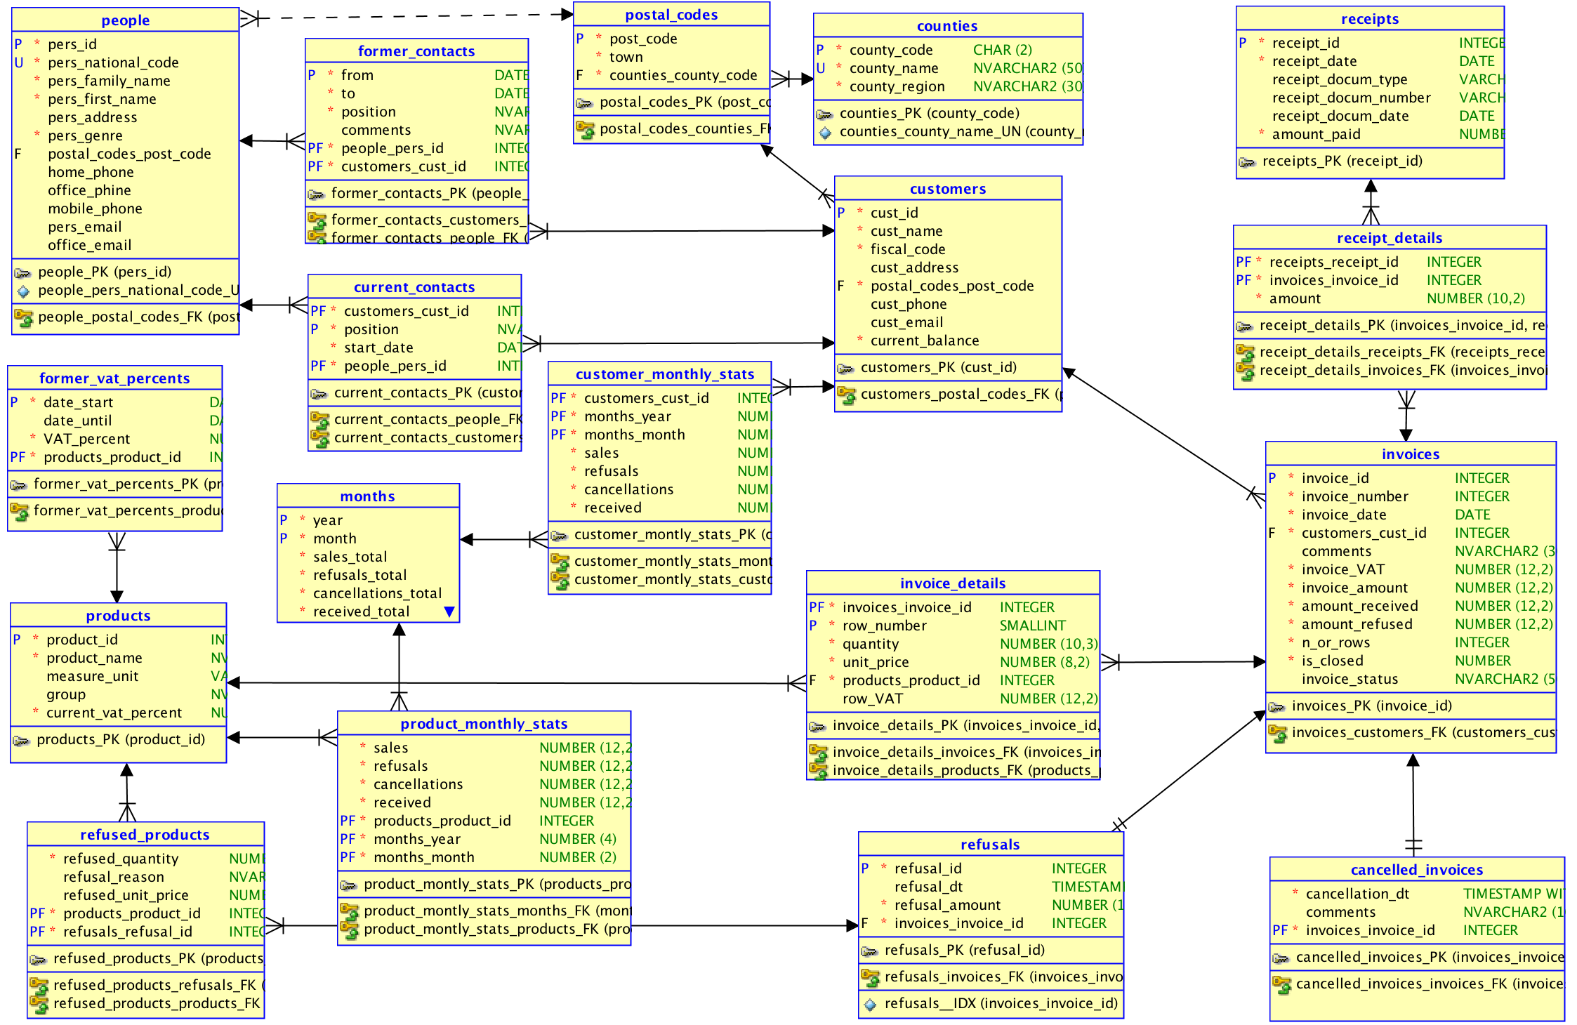
DB Schema

Slide 3
Scripts on GitHub
See section 07_Business Rules with PL SQL of the course:
https://github.com/marinfotache/Database-Logic-in-Business-Applications/tree/master/07_Business%20Rules%20with%20PL%20SQL
Prerequisites (for setting up the database to this point)
06-00-2_fixed_DDL_script_sales_2015.sql
06-00-3_add_constraints_sales_2015.sql
06-01a_en_sequences.sql
06-01b_en_data_cleaning__surrogate_keys.sql
06-01c_en_cascade_updates.sql
06-02a_en_triggers_invoices.sql
06-02b_en_triggers__invoice_details.sql
06-02c_en_triggers__receipts__receipts_details.sql
06-02d_en_proc_auto_ins__receipts.sql
06-03a_en_logs_and_triggers.sql
06-03b_en_general_log.sql
06-03c_en_protecting_denormalized_attributes.sql

Slide 4
07-01a_BusinessRules1__basic_BR.sql
Date/timestamp attribute synchronization for attributes in the same table
"former_contacts.from_" must precede "former_contacts.to_"
"former_vat_percents.date_start" must precede "former_vat_percents.date_until"
"receipts.receipt_docum_date" must precede "receipts.receipt_date"
Date/timestamp attribute synchronization for attributes in different tables
"cancelled_invoices.cancellation_dt" cannot preceed "invoices.invoice_date” "cancelled_invoices" and "invoices" tables synchronization)
"receipt_details.receipt_date" cannot preceed "invoices.invoice_date for current paid invoice
"refusals.refusal_dt" cannot preceed "invoices.invoice_date” (both "refusals" and "invoices" tables synchronization
Other simple business rules
invoices paid with the same receipt cannot refer to two or more customers (each payment/receipt is made by a single customer for its invoice(s)
a product cannot change VAT percent more than once in the same day

Slide 5
07-01a_BusinessRules1__basic_BR.sql
Date/timestamp attribute synchronization for attributes in the same table
"former_contacts.from_" must precede "former_contacts.to_"
"former_vat_percents.date_start" must precede "former_vat_percents.date_until"
"receipts.receipt_docum_date" must precede "receipts.receipt_date"
Date/timestamp attribute synchronization for attributes in different tables
"cancelled_invoices.cancellation_dt" cannot preceed "invoices.invoice_date” "cancelled_invoices" and "invoices" tables synchronization)
"receipt_details.receipt_date" cannot preceed "invoices.invoice_date for current paid invoice
"refusals.refusal_dt" cannot preceed "invoices.invoice_date” (both "refusals" and "invoices" tables synchronization
Other simple business rules
invoices paid with the same receipt cannot refer to two or more customers (each payment/receipt is made by a single customer for its invoice(s)
a product cannot change VAT percent more than once in the same day

